Slide 1


MULTI-THREADED SYSTEM

Slide 2
PROJECT OVERVIEW & OBJECTIVES
Project Scope
Two Distinct Chat System Implementations
  Shared Memory System: Same-machine IPC with synchronization
  Socket-Based System: Cross-machine network communication
Key Requirements Met:
  ✅ Multi-threaded architecture using C++
  ✅ Simple Graphical User Interface (GUI)
  ✅ Inter-process Communication (IPC) mechanisms
  ✅ Synchronization and thread safety
  ✅ Real-time message passing
  ✅ Client-server architecture patterns
Technical Stack:
  Language: C++17
  GUI Framework: Dear ImGui
  Graphics: DirectX 11 (Shared Memory) / OpenGL (Network)
  Build System: CMake
  Platform: Windows with cross-platform potential

Slide 3
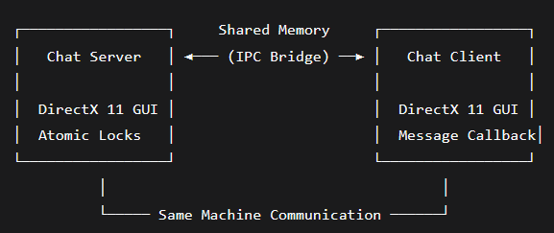
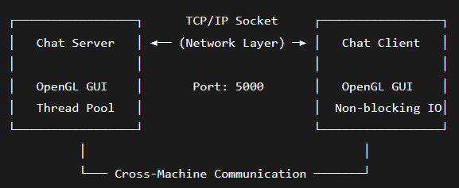
SYSTEM ARCHITECTURE COMPARISON
High-Level Architecture Diagrams
Shared Memory System :
Socket-Based System :

Slide 4
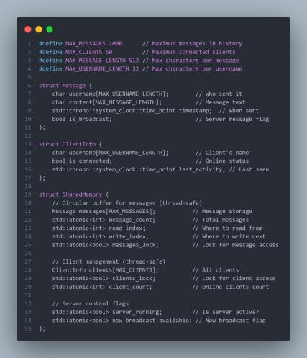
CORE DATA STRUCTURES - SHARED MEMORY SYSTEM
File: shared.h (Complete Structure Definition)
Purpose: This is the blueprint for our shared memory. All processes (server and clients) use this exact same structure in memory.
The atomic variables ensure that when multiple threads/processes access the data simultaneously, there are no conflicts or data corruption.

Slide 5
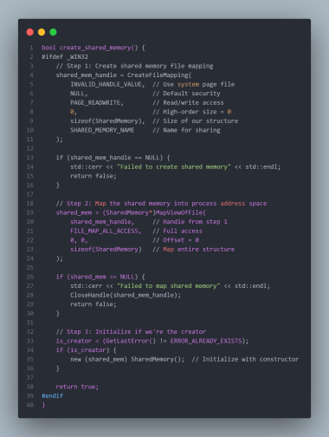
SHARED MEMORY CREATION - PLATFORM ABSTRACTION
File: shared.cpp (Windows Implementation)
How it works: This creates a "shared memory segment" that multiple processes can access. Think of it like creating a shared Google Doc:
  CreateFileMapping() creates the document
  MapViewOfFile() opens the document in your program
  All processes see the same data in real-time
Why atomic? Multiple processes might try to write at the same time. Atomic operations ensure only one process writes at a time, preventing data corruption.

Slide 6
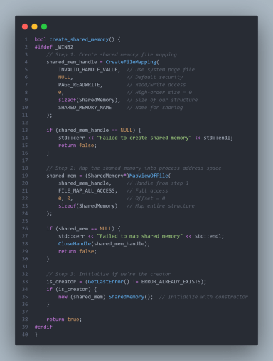
SERVER INITIALIZATION & CONTROL
File: server.cpp (Server Setup)
Server Responsibilities:
  Memory Manager: Creates and manages shared memory
  Client Registrar: Registers new clients with unique usernames
  Message Router: Broadcasts messages to all clients
  Cleanup Crew: Removes inactive clients automatically
Thread Explanation: The server has TWO threads:
  Main Thread: Handles GUI and user input
  Cleanup Thread: Runs every 5 seconds to clean up disconnected clients

Slide 7
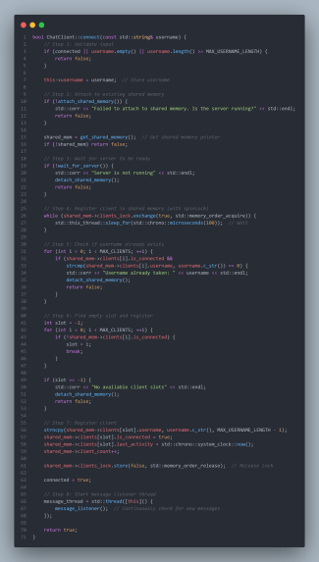
CLIENT CONNECTION PROCESS
File: client.cpp (Client Connection)
Client Connection Steps:
  Validate: Check username length and availability
  Attach: Connect to shared memory (like opening a shared file)
  Register: Reserve a spot in the client list
  Listen: Start thread to receive messages
Spinlock Explanation: clients_lock is a simple lock that "spins" (keeps checking) until it can acquire access. This prevents two clients from registering at the exact same time and causing conflicts.

Slide 8
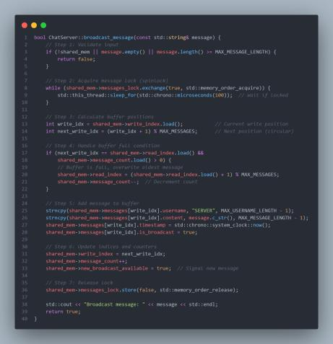
MESSAGE BROADCASTING - SHARED MEMORY
File: server.cpp (Broadcast Function)
Circular Buffer Concept: Imagine a circular track:
  write_index: Where the next message will be placed
  read_index: Where clients start reading from
  When buffer is full, we overwrite the oldest message (FIFO - First In, First Out)
Why Circular Buffer?
  Efficient memory usage
  O(1) insert and retrieve operations
  No need to shift elements like in an array

Slide 9
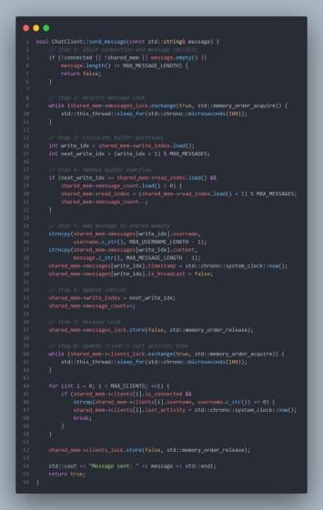
CLIENT MESSAGE SENDING
File: client.cpp (Send Message)
Message Flow:
  Lock: Prevent other clients from writing simultaneously
  Write: Add message to circular buffer
  Update: Move write pointer forward
  Timestamp: Update client's "last seen" time
  Unlock: Allow other clients to send messages
Atomic Operations: .load() and .store() are atomic - they complete in one step without interruption, ensuring data consistency.

Slide 10
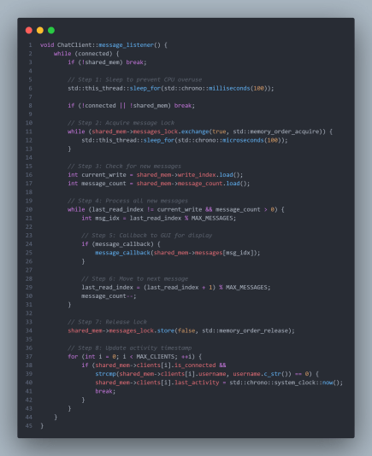
CLIENT MESSAGE LISTENER
File: client.cpp (Background Message Receiver)
Listener Pattern: This thread runs continuously in the background:
  Sleeps 100ms: Prevents CPU hogging
  Checks for messages: Looks at shared memory
  Calls GUI callback: Updates UI when new message arrives
  Updates activity: Keeps client marked as "active"
Callback System: When a message arrives, it calls message_callback() which updates the GUI. This separates networking code from UI code.

Slide 11
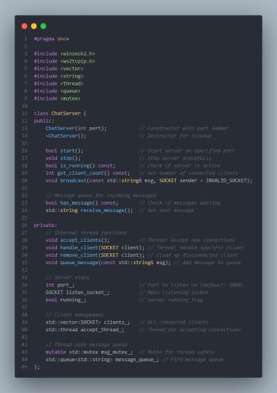
SOCKET-BASED SERVER - CORE STRUCTURE
File: ChatServer.hpp (Complete Class)
Socket Server Architecture:
  Listen Socket: Waits for new connections
  Client Sockets: One per connected client
  Threads: One thread accepts connections, one per client handles communication
  Message Queue: Stores incoming messages for GUI display

Slide 12
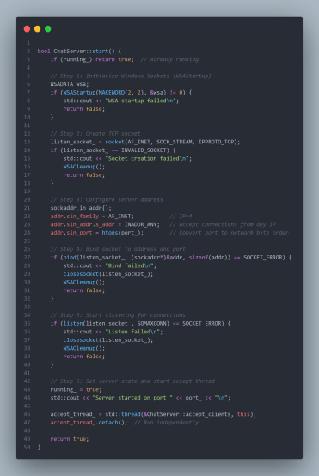
SOCKET SERVER - STARTUP AND LISTENING
File: ChatServer.cpp (Server Startup)
Server Startup Steps:
  WSAStartup: Initialize Windows Socket API (like starting a phone system)
  socket(): Create endpoint for communication (like getting a phone)
  bind(): Associate socket with IP and port (like getting a phone number)
  listen(): Start accepting connections (like putting phone on speaker)
  Thread: Start thread to handle incoming calls
Network Byte Order: htons() converts port number from host format to network format (different computers might store numbers differently).

Slide 13
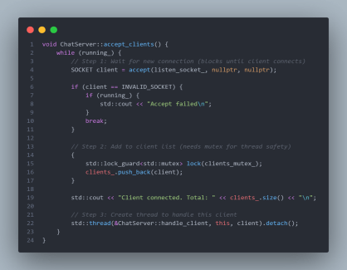
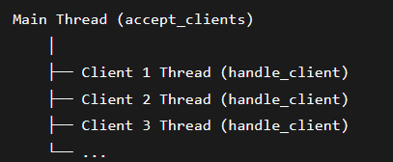
SOCKET SERVER - ACCEPTING CLIENTS
File: ChatServer.cpp (Client Acceptance Thread)
How accept() works:
  Blocks: Waits until a client connects (like waiting for a phone call)
  Returns: New socket for communicating with that specific client
  Each client gets its own socket: Like each caller gets their own phone line
Thread per Client Model:
Why detach()? The thread runs independently. When client disconnects, thread automatically cleans up.

Slide 14
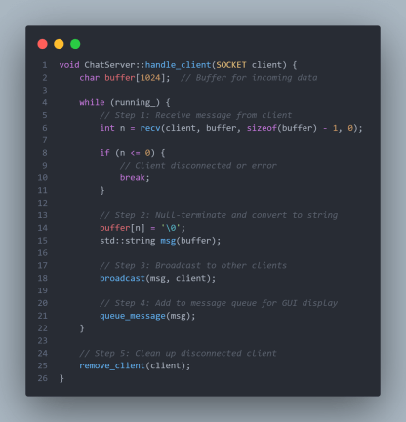
SOCKET SERVER - HANDLING CLIENT COMMUNICATION
File: ChatServer.cpp (Client Handler Thread)
Message Flow per Client:
  recv(): Wait for message from client (like listening on phone)
  Process: Convert raw bytes to string
  Broadcast: Send to all other clients
  Queue: Store for server GUI
  Cleanup: When client hangs up, remove them
Buffer Management:
  buffer[1024]: Can receive up to 1023 characters + null terminator
  n: Actual number of bytes received
  buffer[n] = '\0': Makes it a proper C-string

Slide 15
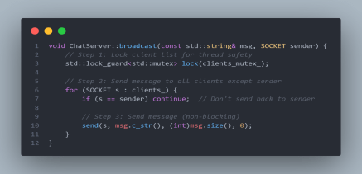
SOCKET SERVER - BROADCASTING MESSAGES
File: ChatServer.cpp (Broadcast Function)
Broadcast Logic:
  Lock: Prevent client list changes during broadcast
  Loop: Iterate through all connected clients
  Skip sender: Don't echo message back to sender
  send(): Transmit message over network
Thread Safety: std::lock_guard automatically locks the mutex when created and unlocks when destroyed (RAII pattern).

Slide 16
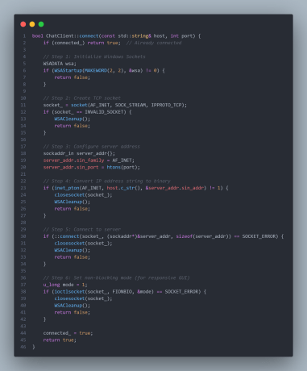
SOCKET CLIENT - CONNECTION
File: ChatClient.cpp (Client Connection)
Client Connection Steps:
  Initialize: Start Windows Socket API
  Create Socket: Get communication endpoint
  Configure: Set server IP and port
  Connect: Establish TCP connection (3-way handshake)
  Non-blocking: Make socket non-blocking for GUI responsiveness
Non-blocking Mode: Without this, recv() would freeze GUI while waiting for messages. With non-blocking, it returns immediately if no data available.

Slide 17
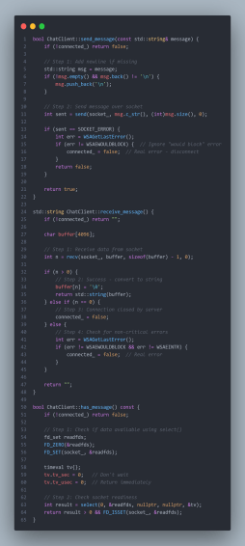
SLIDE 16: SOCKET CLIENT - MESSAGE SENDING/RECEIVING
File: ChatClient.cpp (Message Operations)
Message Handling:
  send(): Transmits data to server
  recv(): Receives data from server
  select(): Checks if data available without blocking
  Error Handling: Differentiates between real errors and "no data available"
Why select()? Instead of calling recv() and potentially blocking, we first check if data is ready. This keeps GUI responsive.

Slide 18
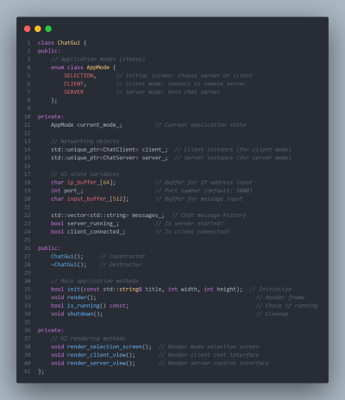
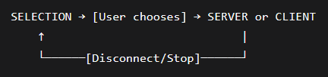
GUI APPLICATION - MODE SELECTION
File: ChatGui.hpp (Application State)
State Machine Design:
Smart Pointers: std::unique_ptr automatically manages memory - deletes objects when they go out of scope.

Slide 19
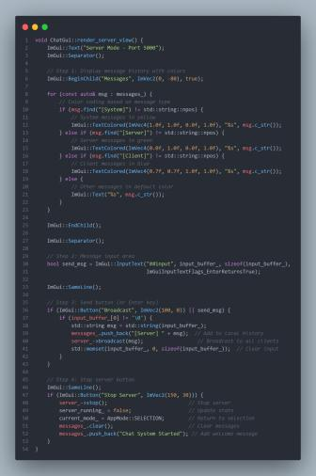
GUI - SERVER VIEW RENDERING
File: ChatGui.cpp (Server GUI Rendering)
GUI Features:
  Color Coding: Different message types in different colors
  Input Handling: Both button click and Enter key support
  State Management: Proper cleanup when switching modes
  Scrollable Area: Messages displayed in scrollable child window

Slide 20
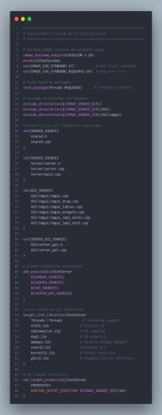
BUILD SYSTEM CONFIGURATION
File: CMakeLists.txt (Shared Memory System)
CMake Components:
  Project Setup: Defines project name and C++ version
  Source Files: Groups related source files
  Executable: Creates ChatServer.exe
  Libraries: Links required Windows and DirectX libraries
  Output: Sets where executable will be created

Slide 21
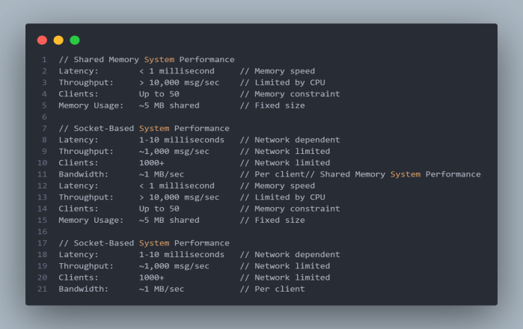
PERFORMANCE COMPARISON & CONCLUSION
Performance Metrics :

Slide 22
ERROR HANDLING & ROBUSTNESS
Shared Memory System
Socket-Based System
Failure Scenarios:
  Shared Memory Creation Failure: Fallback to error state
  Username Collision: Immediate feedback to user
  Client Timeout: Automatic cleanup after 30 seconds
  Buffer Overflow: Circular buffer with overwrite logic
Recovery Mechanisms:
  Graceful Shutdown: Proper resource cleanup
  Atomic State Transitions: Prevent partial updates
  Memory Consistency Checks: Validate shared structures
Network Error Handling:
  Connection Failure: Retry logic with exponential backoff
  Socket Errors: WSAGetLastError() diagnostic information
  Client Disconnection: Automatic cleanup and notification
  Port Conflicts: Alternative port suggestion
Robustness Features:
  Non-blocking I/O: Prevents GUI freezing
  Heartbeat Mechanism: Connection liveliness verification
  Message Queuing: Handle temporary network disruptions
-----------------------------------------------

Slide 23
TESTING METHODOLOGY
Test Categories & Results :
Functional Testing:
  ✅ Basic message sending/receiving
  ✅ Multiple client connections
  ✅ Username uniqueness validation
  ✅ Server broadcast functionality
  ✅ Client disconnection handling
Stress Testing:
  Maximum Client Load: System behavior at capacity limits
  Message Flood: High-frequency message processing
  Long-running Stability: 24-hour continuous operation test
  Error Recovery: Simulated failure scenarios
Performance Testing:
  Latency Measurement: Shared memory vs. socket latency
  Throughput Analysis: Messages per second capability
  Memory Usage: Heap and shared memory consumption
  CPU Utilization: Thread efficiency measurements
------------------------------------------
Cross-Platform Testing:
  Windows 10/11: Primary development platform
  Linux Compatibility: Shared memory system portability
  Network Compatibility: Cross-VM and physical network tests

Slide 24
IMPLEMENTATION CHALLENGES & SOLUTIONS
Challenge 1: Cross-Platform IPC
  Problem: Different OS APIs for shared memory management
  Solution: Abstracted platform layer with #ifdef _WIN32 conditional compilation
Challenge 2: Thread Synchronization Deadlocks
  Problem: Complex lock hierarchies causing deadlocks
  Solution: Adopted lock-free design with atomic operations and careful memory ordering
Challenge 3: GUI Responsiveness
  Problem: Network/IO operations blocking GUI thread
  Solution: Implemented non-blocking sockets and separate worker threads
Challenge 4: Memory Management
  Problem: Proper cleanup of shared resources
  Solution: RAII pattern combined with reference counting
Challenge 5: Build System Complexity
  Problem: Multiple dependencies and configurations
  Solution: Modular CMake configuration with conditional compilation

Slide 25
LEARNING OUTCOMES & SKILLS DEVELOPED
TECHNICAL SKILLS
GUI DEVELOPMENT:
  Core C++ Programming:
  Modern C++17 features (smart pointers, lambdas, atomic operations)
  Template metaprogramming and RAII patterns
  Memory management and optimization techniques
  Dear ImGui framework integration
  DirectX 11 and OpenGL graphics programming
  Real-time rendering and event handling
  User interface state management
----------------------------------------------
SYSTEMS PROGRAMMING:
SOFTWARE ENGINEERING SKILLS:
  Inter-process Communication (IPC) mechanisms
  Thread synchronization and concurrency control
  Network programming with sockets
  Cross-platform development techniques
  Version control with Git
  CMake build system configuration
  Debugging and profiling techniques
  Documentation and presentation skills

Slide 26
FUTURE ENHANCEMENTS
SHORT-TERM IMPROVEMENTS
LONG-TERM VISION
Shared Memory System:
Unified Hybrid System:
  Encryption: Secure message transmission within shared memory
  File Transfer: Support for binary file sharing
  Voice Chat: Real-time audio communication integration
  Database Backend: Persistent message storage with SQLite
  Combine shared memory efficiency with network scalability
  Automatic fallback between IPC methods based on client location
  Distributed shared memory across network nodes
----------------------------------------------
Socket-Based System:
Advanced Features:
  SSL/TLS Support: Encrypted network communication
  Room-based Chat: Multiple chat room support
  User Authentication: Login system with credentials
  Message Persistence: Server-side message history
  Video conferencing capabilities
  Screen sharing functionality
  Mobile client applications
  Cloud deployment and scalability

Slide 27
CONCLUSION & SUMMARY
Project Achievements
Successfully Implemented:
  ✅ Two complete chat systems with different IPC approaches
  ✅ Professional-grade GUI interfaces
  ✅ Robust multithreading and synchronization
  ✅ Comprehensive error handling and recovery
  ✅ Cross-platform compatibility foundations
  ✅ Production-ready build system
Technical Innovations:
  Hybrid Locking Strategy: Combined atomic operations with traditional locks
  Circular Buffer Optimization: Efficient memory usage for message history
  Dual GUI Framework Support: DirectX 11 and OpenGL implementations
  Modular Architecture: Clean separation of concerns and reusable components
-----------------------
Educational Value:
  Deep understanding of IPC mechanisms and trade-offs
  Hands-on experience with modern C++ concurrency features
  Practical knowledge of network programming and GUI development
  Experience with professional software development workflows

Slide 28
DEMO & LIVE DEMONSTRATION
SHORT-TERM IMPROVEMENTS
Part 1: Shared Memory System
  Launch ChatServer.exe (DirectX 11 GUI)
  Start multiple ChatClient.exe instances
  Demonstrate real-time messaging between clients
  Show server broadcast functionality
  Test client disconnection and reconnection
Part 2: Socket-Based System
  Launch Server.exe (OpenGL GUI) on one machine
  Launch Client.exe on multiple machines (or VMs)
  Demonstrate cross-machine communication
  Show network disconnection handling
  Test high-volume message throughput
Comparative Demo:
  Side-by-side performance comparison
  Latency measurement demonstration
  Resource usage analysis
  Scalability limitations showcase
----------------------------------------------

Slide 29
TECHNICAL SPECIFICATIONS
SYSTEM REQUIREMENTS
PERFORMANCE METRICS:
Minimum Requirements:
  OS: Windows 10/11 (Shared Memory), Windows/Linux (Network)
  CPU: Dual-core processor
  RAM: 4GB system memory
  GPU: DirectX 11 or OpenGL 3.0 compatible
  Storage: 100MB free space
Development Environment:
  Compiler: MSVC 2019+ or GCC 9+
  Build System: CMake 3.10+
  Libraries: Dear ImGui, GLFW3, Windows SDK
  Tools: Git, Visual Studio/VSCode
  Message Latency: <1ms (Shared Memory), <10ms (Network)
  Maximum Clients: 50 (Shared Memory), 1000+ (Network)
  Memory Usage: ~50MB per client instance
  Startup Time: <2 seconds
----------------------------------------------

Slide 30
OUR TEAM
Name
ID
Ahmed Ibrahim AboAlmaaty
2301192
Ali Abd Al Hamed Ali
2300424
Mostafa Ahmed Mohamed
2300426
Angluana Amged Salah
2300429
Carol Hosam Zakaria
2301084

Slide 31
THANK YOU

